Slide 1

TRUST ISSUES BETWEEN THE POLICE & A BLACK CHURCH:POST TRAYVON MARTIN
Dr. Benjamin Roberts, LMFT, BCPC, BCPCC

Slide 2

Who Am I
Dr. Benjamin Roberts, LMFT, Tennessee & Kentucky
B. A. Religious Education, Lipscomb University
M.A. Counseling, Harding School of Theology
M.A. Business Organization & Executive Leadership, Liberty University
DBS. Bethany Theological Seminary
Dmin. Family Therapy, Amridge University
Minister at the West Eastland church of Christ, Gallatin, TN for 24 years

Slide 3
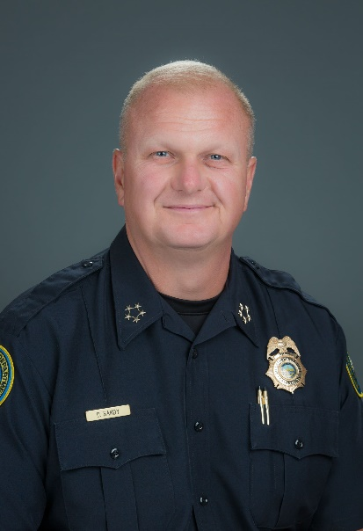
APPRECIATION
Chief Don Bandy

Slide 4
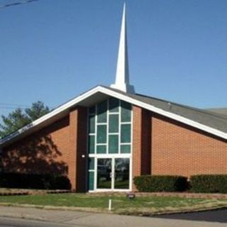
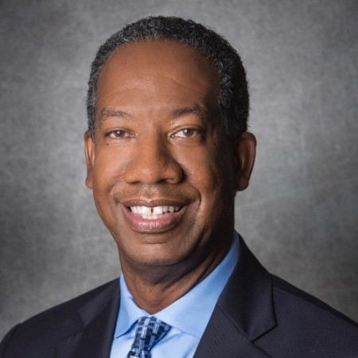
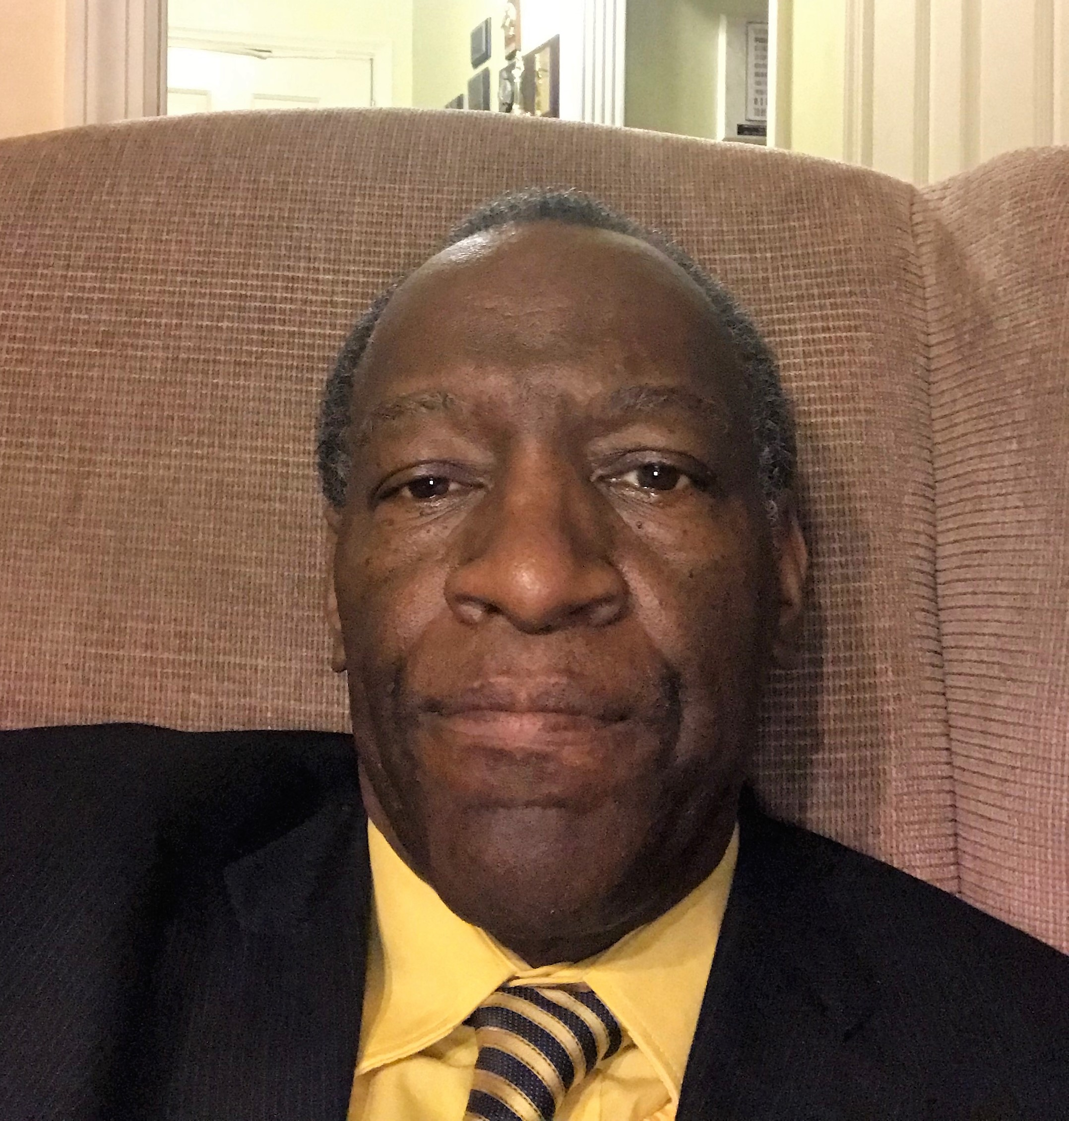
West Eastland Church of Christ

Slide 5
Introduction
There has been an increase in police injustice toward African Americans, including public cases involving police shooting or killing unarmed males (Brunson, Braga, Hureau, & Pegram, 2015)
There is a need for the church to do more toward developing trust between police and the African American community

Slide 6
Theoretical Framework III
Contextual theory (Boszormenyi-Nagy, 1997)
  Concerns fairness, loyalty, trust, and entitlement within families
  Multi-directed partiality: Listening to and recognizing others’ viewpoints is critical in resolving issues

Slide 7
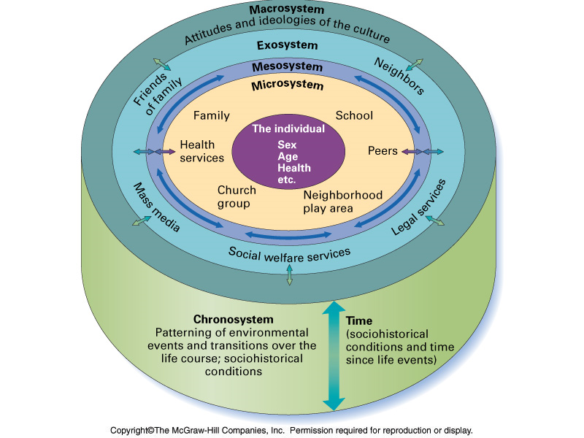
Bronfenbrenner Ecological Model

Slide 8
Method
Qualitative (Major & Savin-Baden, 2010)
  Aims to explore, investigate, explain, or describe a phenomenon within an uncontrollable environment
  Utilizes data about individuals’ perceptions, experiences, and behaviors

Slide 9
Data Analysis
Thematic analysis (Braun & Clarke, 2014)
  Explored and identified the participants’ most important perceptions
  Interpreted perceptions strictly based on how they were shared
  Reported the major/minor themes

Slide 10
WHAT IS TRUST?
Simpson (2012) states that trust is hard to define. However, he conveys that this does not mean that there is no philosophical understanding of the concept to be had, but the answer he recommends is that in existing communally, individuals must trust others to act supportively.

Slide 11
WHAT IS TRUST?
“Thus ‘trust’ is an umbrella term under which plural notions cluster” (p. 551). Some actions point toward defining trust. The African-American community and police need the support of each other to maintain law in the community.

Slide 12
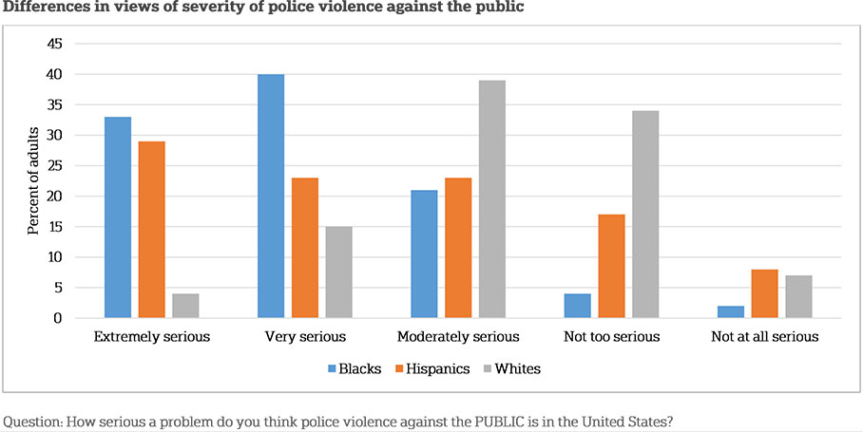
Differences in views of severity of police violence against public

Slide 13
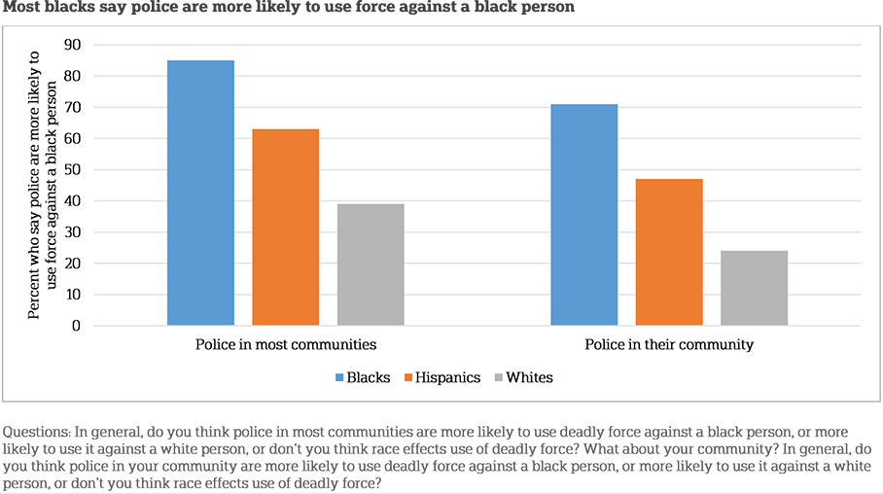
Most blacks say police are more likely to use force against a black person

Slide 14
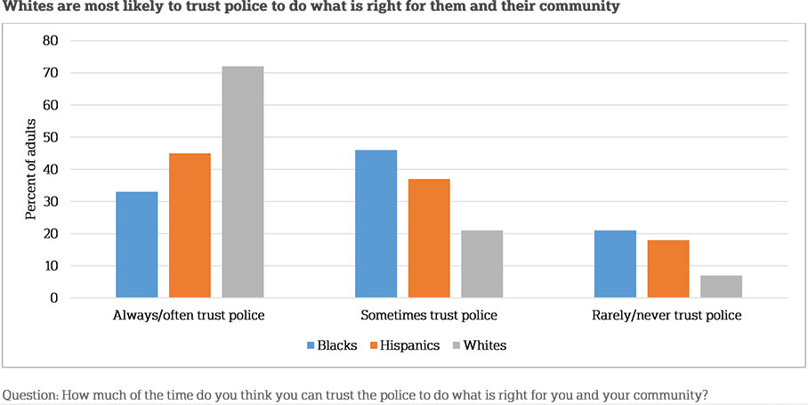
Whites are most likely to trust police to do what is right for them and their community

Slide 15
Appendix D
Summary of Major Themes Addressing Research Questions One to Three
Summary of Themes for Groups A and B
Research Question | Focus Group A | Focus Group B
RQ One: How has the outreach program of this church help build trust with the police department? | Familiarizing of community members with the police department *Having the opportunity to communicate openly with the officers *Seeing the officers as normal human beings *Continuing the presence and visibility of the police members *Seeing the police members as community models | Familiarizing of community members with the police department *Having the opportunity to interact and communicate closely with the community members *Modifying the image and perceptions of police officers *Seeing the officers as normal human beings
RQ Two: What is the role of this church in helping the outreach program build trust? | Building a strong foundation for the youth community members *Mentoring the youth and leading them to the right path | Note: Only minor themes were discovered

Slide 16
Appendix D
Summary of Major Themes Addressing Research Questions One to Three
Summary of Themes for Groups A and B
RQ Two: What is the role of this church in helping the outreach program build trust? | Building a strong foundation for the youth community members *Mentoring the youth and leading them to the right path | Note: Only minor themes were discovered
RQ Three: What is the role of the police department in helping the outreach program build trust? | Making themselves more visible and approachable to the community members *Improving the image of the police officers *Needing policemen of color, community members can relate to | Needing to improve the community’s perceptions of the police *Lacking appreciation for the hard work of the police
RQ Four: How does Ecological Systems Theory (Collaboration) assist in helping the outreach program build trust? | Developing the initiative to collaborate with and help one another | Developing the initiative to collaborate with and help one another

Slide 17
POLICE AND MINISTERS COLLABORATION
One example of police and African-American pastors collaborating is in Boston Massachusetts. In 1992, a group of black activist clergy formed The Ten Point Coalition (TPC) after a gang assault on the Morningstar Baptist Church in Boston Massachusetts.

Slide 18
POLICE AND MINISTERS COLLABORATION
Rival gang members of the deceased attacked grieving friends and family with guns and knives. Consequently, the TPC ministers felt a calling to help the community control gang activity and prevent youth from joining (Braga, 2003).

Slide 19
POLICE AND MINISTERS COLLABORATION
The ministers worked closely with the Boston police to successfully create and implement the well-known Operation Cease Fire initiative. The goal of Operation Cease Fire, implemented in the mid-1990s, was to crack down on gang activities on the streets of Boston.

Slide 20
POLICE AND MINISTERS COLLABORATION
The community, especially ministers, participated in varies ways to assist police in executing anti-violence operations and offer programs that would deter youth from crime (Braga, 2003).

Slide 21
RECOMMENDED MODEL
Source: U.S. Dept of Justice (2007, p.8)

Slide 22
Black & Blue Developing Trust and Collaboration for community Safety
Dr. Benjamin Roberts, LMFT, BCPC, BCPCC

